Slide 1
VETERINARY MONITORING OF ZOONOTIC BACTERIA RESISTANCE TO ANTIMICROBIALS
Dmitry Makarov
Department of Feed and Feed Additives safety

Slide 2
ANTIMICROBIAL RESISTANCE (AMR) IS A GLOBAL THREAT TO MANKIND
According to WHO, resistance of pathogenic bacteria to antimicrobial drugs is to date one of the most serious global threats to mankind.
In Europe alone in 2011 resistant microorganisms led to death of 37000 people and financial losses of 7 billion euro.*
In USA resistant bacteria annually infect more than 2 million people, of which 23000 die, and economical losses related to minimization of resistant bacteria dissemination are appoximately 20 billion dollars per year.**
Globally, according to WHO, number of infections caused by resistant bacteria raises constantly. Some experts forecast, that if the situation does not change, annual mortality caused by resistant infections will be about 400.000 in Europe, 300.000 in North America and 5.000.000 in Asian Region (including Russia)***
*World Health Organization , author. Report on the burden of endemic health care-associated infection worldwide. Geneva: WHO Document Production Services; 2011.
**Center for Disease Control and Prevention. Antibotics Resistance Threats in the USA, 2013.
***Lord Jim O’Neil. Antimicrobial Resistance: Tackling a crisis for the health and wealth of nations. The Review on Antimicrobial Resistance, 2014.

Slide 3
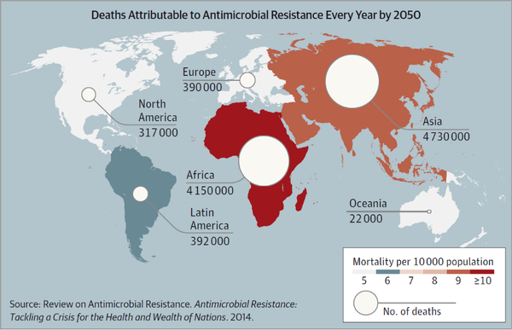
ANTIMICROBIAL RESISTANCE (AMR) IS A GLOBAL THREAT TO MANKIND

Slide 4
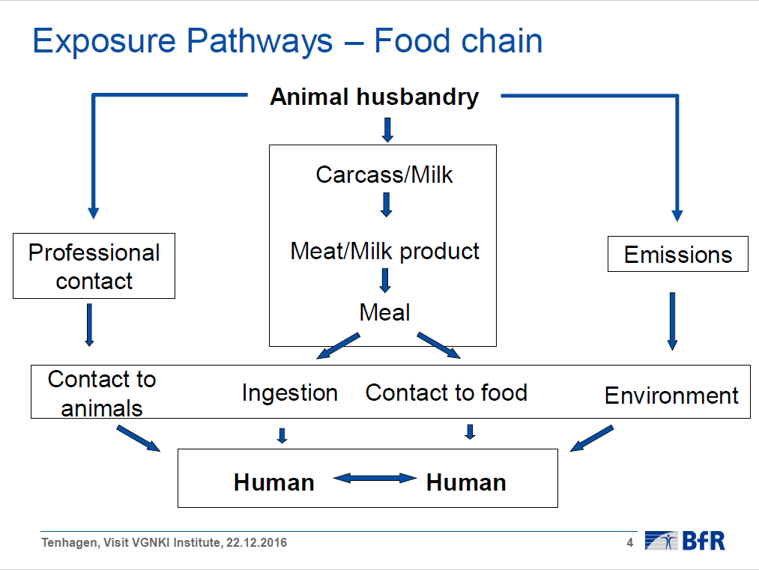
-
The slide was kindly provided by Dr. Tenhagen from BfR

Slide 5
ENVIRONMENTAL PATHWAY
It is becoming increasingly recognized that not only antibiotic resistance genes (ARGs) encountered in clinical pathogens are of relevance, but rather, all pathogenic, commensal as well as environmental bacteria-and also mobile genetic elements and bacteriophages-form a reservoir of ARGs (the resistome) from which pathogenic bacteria can acquire resistance via horizontal gene transfer (HGT).
HGT has caused antibiotic resistance to spread from commensal and environmental species to pathogenic ones, as has been shown for some clinically important ARGs.
Of the three canonical mechanisms of HGT, conjugation is thought to have the greatest influence on the dissemination of ARGs. While transformation and transduction are deemed less important, recent discoveries suggest their role may be larger than previously thought.

Slide 6
The slide was kindly provided by Dr. Tenhagen from BfR

Slide 7
The slide was kindly provided by Dr. Tenhagen from BfR

Slide 8
VETERINARY USE OF ANTIMICROBIALS AND THE PROBLEM OF AMR
Many countries in the worlds (France, Denmark, Netherlands, Germany, Belgium, Spain, China, USA etc.) elaborate their strategies of struggle against antimicrobial resistance basing on the conclusion that limiting of AB use in livestock will lead to the decrease of resistance.
This conclusion is supported by large pool of scientific data. Some examples:
-In Denmark it was shown that ban or decrease in veterinary use of avilamycin, erythromycin, vancomycin, virginiamycin and tylosin led to significant decrease in percent of resistant Enterococcus isolates obtained from poultry and pigs. For ex. avoparcin ban in 1995 was followed by a decrease in the occurrence of glycopeptide-resistant E. faecium (GRE) in broilers, from 72.7% in 1995 to 5.8% in 2000 (Aarestrup et al, 2001).
In Netherlands in was shown that decrease of AB use for pigs by 54% led to reduction in resistance by 22% in several years. For veal – 28% and 26%, respectively (Hetty van Beers-Schreurs, 2015)

Slide 9
VETERINARY APPLICATION OF ANTIMICROBIALS AND THE PROBLEM OF AMR
In Belgium correlations were evaluated between AB use and the prevalence of resistance in commensal E. coli isolates from pigs, poultry and cattle, using data from publicly available national or international reports from seven European countries. The level of use of specific antimicrobials strongly correlated to the level of resistance towards these agents with coefficients of determination 0.99 for fluoroquinolones and amphenicols, 0.94 for third-generation cephalosporins and sulphonamides etc. (Chantziaras et al., 2014).
Some research works demonstrate that in organic farms resistance is significantly lower, than in convenient farms. In organic dairy farms the resistant isolates are predominantly non sensitive to old and very wide-spread drugs, while in convenient farms bacteria often show resistance to a broad range of AB, including critically important to medicine (Tenhagen et al., 2014). In the conventional poultry houses, 81% of E. faecium were resistant, while 12% contained the tetramycin resistance gene in the organic farms (Sapkota et al., 2011).

Slide 10
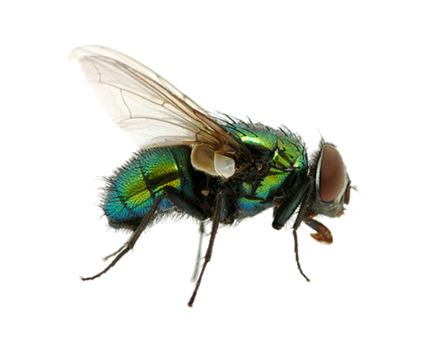
COLISTIN BAN IN CHINA
The situation with colistin in China is a good example how veterinary use of AB leads to resistance in humans.
Colistin is one the most important AB of «last resort». In China it was used as growth promoter in animal husbandry, and ¼ part of E.coli isolates from poultry farms and livestock products from markets are resistant to colistin.
Recently resistance to colistin was found in E.coli from 1% of hospitals in two large cities, though the drug has no medical application in China.
Genetic determinants of resistance to colistin were similar for bacteria from chicken farms, slaughterhouses, supermarkets and people. Resistant bacteria were also isolated from flies (Wang et al., 2017).
The authors concluded that resistance emerged in poultry farms and than was transferred to hospitals.
«It may be why hospital patients who lived far away from farms were not less likely to have a resistant infection during summer, says one of the authors. “In the summer flies will carry those bacteria everywhere.” ( MacKenzie, 2017 )
This situation led to the decision of banning colistin use
as feed additive in China.

Slide 11
EFFORTS OF INTERNATIONAL COMMUNITY AGAINST AMR
MEASURES FOR MINIZATION OF AMR IN THE FIELD OF ANIMAL HUSBANDRY UNDERTAKEN BY EUROPEAN AND OTHER COUNTRIES
• Coordination of different government agencies efforts at regional, national and international level, including ministries of health and agriculture.
• Enforcement of laws regulating antimicrobials use in animal husbandry and enforcement requirements for authorization of antimicrobials.
• Limitation of veterinary use of antimicrobials, critically important for antimicrobials for medicine on a first priority basis, including some cephalosporins and fluoroquinolones.
Ban on use of antimicrobials as growth stimulators – since 2003 in Europe, since 2015 in USA. In Russian Federation antimicrobials are also not authorized as growth promoters.
Improvement of sanitary conditions in animal husbandries.
Increased use of alternative drugs for prevention and treatment of bacterial infections: probiotics, prebiotics, organic acids, plant essential oil, vaccines, bacteriophages etc.
Basis for all measures: Veterinary monitoring of antimicrobial resistance and veterinary antimicrobial drugs use.

Slide 12
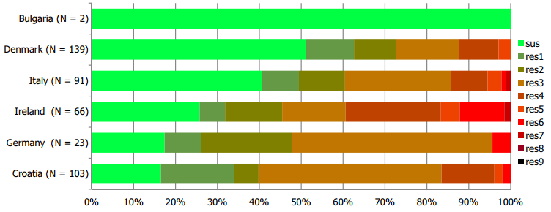
MONITORING OF AMR IN EUROPE
Each several years European Union publishes a report on antimicrobial resistance. The last one was published this year and contains data from 28 member countries in Salmonella, Campylobacter, Staphylococcus and E.coli isolated from humans, animal farms and food products.
Multidrug resistance in Salmonella spp. isolates from fattening pigs*
* The European Union summary report on antimicrobial resistance in zoonotic and indicator bacteria from humans, animals and food in 2017

Slide 13
VETERINARY MONITORING OF AMR IN RUSSIA
In 2014 FGBI «Cental Scientific and Methodological Veterinary Laboratory» made a scientific report about resistance in Salmonella isolated from cattle, pigs, poultry, sheeps, horses and bees and other animals*.
In 2017 FGBI «ARRIAH» published an article with data on antimicrobial resistance of Listeria isolated from food products of animal origin**.
In 2010-2015 VGNKI made a comparison of 200 Salmonella isolates from the VGNKI museum collection obtained in 1948-2009 and 108 isolates obtained in 2010-2012 from food products, feed and animal biomaterial. Recently isolated strains showed a 2-fold increase in ampicillin and doxicyclin and 1.8 –fold increase in streptomycin resistance. Also intermediate resistance to critically important antimicrobials ciprofloxacin and norfloxacin raised significantly – by 3.9 and 5.6-fold, respectively***. Resistance genes were investigated****.
* FGBI «CSMVL» report, 2014. Analysis of epidemoilogical situation with Salmonella in Russian Federation.
** Skitovich et al. Antimicrobial susceptibility of Listeria isolated from food products. Veterinary Science Today. June №2 {21} 2017
*** Zubritsky et al. Molecular mechanisms of Salmonella resistance to aminoglycosides. Antibiotics and chemotherapy– 2011. - т.56. - №9-10. - с.7-12
**** FGBI «VGNKI» scientific report, 2014. Investigation of Salmonella antimicrobial resistance.

Slide 14
NEED FOR NATIONAL ACTION PLAN
WHO encourages it’s member countries to develop complex measures to control antimicrobial resistance, basing on «One Health Approach», involving human and animal health. OIE gives to it’s member countries the following recommendation:*
«The OIE is committed to supporting Veterinary Services of Member Countries to build their capacity as well as to develop and implement National Action Plans for AMR, to regulate and promote prudent use of antimicrobial agents, and to implement monitoring and surveillance»
Russian Federation is going to develop such National Action Plan, including the plan for controlling AMR in animal husbandry,
One the most important parts of the latter, should, of course, be the National monitoring program of zoonotic bacteria AMR.
*The OIE Strategy on Antimicrobial Resistance and the Prudent Use of Antimicrobials. November 2016.

Slide 15
VGNKI MONITORING PROGRAM OF ZOONOTIC BACTERIA AMR
VGNKI is now performing a new program of AMR monitoring.
We perform susceptibility testing of isolates by internationally harmonized CLSI standard broth microdilution method.
4 groups of bacteria (E. coli, Salmonella sp., Campylobacter spp., и Enterococcus spp) were chosen according to OIE* Recommendations and WHO** Documents. Isolates will be taken from food products (meat, milk, dairy, fish etc) and biomaterial of farm animals (carcasses, lavages, feces, swabs etc.). Identification will be made using Maldi-TOF Mass Spectrometry and classical biochemical tests.
According to OIE Recommendations the minimum number of isolates for 1 microorganism was chosen to be 369 for desired precision of 5% and 95% level of confidence*.
30 antimicrobials from 12 classes were included in the program for susceptibility testing basing on the data of medical and veterinary importance, authorization and sales volumes in Russia , effectivity etc.
*OIE Terrestrial Animal Health Code. Chapter 6.7. Article 6.7.3. The development of antimicrobial resistance surveillance and monitoring programmes.
**Who. Global Priority List of Antibiotic-Resistant Bacteria to Guide Research, Discovery, and Development of New Antibiotics, 2017.

Slide 16
VGNKI MONITORING PROGRAM OF ZOONOTIC BACTERIA AMR
MIC will be interpreted to get data on
-Epidemiological Resistance using EUCAST Breakpoints (ECOFF).
-Clinical Resistance (to know whether particular antibiotic is active againts the tested microorganism isolate in clinical practice) using CLSI, EUCAST and IACMAC* (Russia) breakpoints
Genes of resistance for some isolates will be analyzed using Whole Genome Sequencing method.
Data on resistance will be collected by VGNKI, analyzed, compared with data from other countries and passed to international organizations, including OIE etc.
Risk analysis of antimicrobial resistance of zoonotic bacteria in Russian Federation will allow to make recommendation for controlling AMR.
Results of our work will serve as basis for Russian National Action Plan for AMR in the field of animal husbandry.
*IACMAC - The Interregional Association for Clinical Microbiology and Antimicrobial Chemotherapy (Russia)

Slide 17
LIST OF ANTIMICROBIALS
Penicillins | Lincosamides
Ampicillin | Clindamycin
Аmoxicillin/Clavulanic acid | Amphenicoles
Аmoxicillin | Florphenicol
Cephalosporins | Chloramphenicol
Ceftiofur | Polymyxines
Ceftaroline | Colistin
Cefotaxime | Quinolones
Glicylclines | Enrofloxacin
Tigecycline | Levofloxacin
Tetracyclines | Ciprofloxacin
Doxicycline | Moxifloxacin
Теtracycline | Marbofloxacin
Aminoglycosides | Diaminopyrimidines
Gentamicin | Trimethoprim
Spectinomycin | Trimethoprim/Sulfamethoxazole
Streptomycin | Sulfonamides
Macrolides | Sulfadiazine
Erythromycin | Sulfamethoxazole
Tylosine | Other
Azalides | Rifampicin
Azithromycin | Vancomycin

Slide 18
SOME PRELIMINARY RESULTS FOR E.COLI
Epidemiological Resistance (EUCAST ECOFF)
Antibiotic, number of isolate | 4 | 18 | 32 | 1 | 5 | 6 | 34 | 7 | 3 | 24 | 37 | 23 | 8 | 19 | 36
Ampicillin | S | S | S | S | S | S | S | S | R | S | R | S | R | S | R
Amoxicillin | S | S | S | S | S | S | S | S | R | S | R | S | R | S | R
Ceftiofur | S | R | S | S | S | R | R | S | R | R | R | S | R | R | R
Tetracyclin | S | S | S | S | S | S | R | R | R | S | R | R | R | R | R
Gentamicin | S | S | R | S | R | S | S | S | S | S | S | S | S | S | S
Spectinomycin | S | R | R | S | R | R | R | S | R | R | R | S | R | R | R
Florfenicol | R | S | S | R | S | S | S | S | R | S | R | S | R | R | R
Chloramfenicol | S | S | S | S | S | S | S | S | R | S | R | S | R | S | R
Marbofloxacin
Rifampicin
S | Susceptible
I | Intermediate Resistance
R | Resistant
All isolated were taken from one poultry farm in Yaroslavl oblast.

Slide 19
SOME PRELIMINARY RESULTS FOR E.COLI
Clinical Resistance (CLSI Breakpoints)
Antibiotic, number of isolate | 4 | 18 | 32 | 1 | 5 | 6 | 34 | 7 | 3 | 24 | 37 | 23 | 8 | 19 | 36
Ampicillin | S | S | S | S | S | S | S | S | I | S | I | S | I | S | I
Amoxicillin | S | S | S | S | S | S | S | S | R | S | R | S | R | S | R
Ceftiofur | S | R | S | S | S | R | R | S | R | R | R | S | R | R | R
Tetracyclin | S | S | S | S | S | I | R | R | R | I | R | R | R | R | R
Gentamicin | S | S | I | S | I | S | S | S | S | S | S | S | S | S | S
Spectinomycin
Florfenicol
Chloramfenicol | S | S | S | S | S | S | S | S | R | S | R | S | R | S | R
Marbofloxacin | S | R | S | S | S | S | S | S | R | S | R | S | R | S | R
Rifampicin | S | R | R | I | R | R | R | R | R | R | R | R | R | R | R
S | Susceptible
I | Intermediate
R | Resistant
All isolates were taken from one poultry farm in Yaroslavl oblast.

Slide 20
SOME PRELIMINARY RESULTS FOR E.COLI
Clinical Resistance (EUCAST/MAKMAX Breakpoints)
Antibiotic, number of isolate | 4 | 18 | 32 | 1 | 5 | 6 | 34 | 7 | 3 | 24 | 37 | 23 | 8 | 19 | 36
Ampicillin | S | S | S | S | S | S | S | S | R | S | R | S | R | S | R
Amoxicillin | S | S | S | S | S | S | S | S | R | S | R | S | R | S | R
Ceftiofur
Tetracyclin | S | S | S | S | S | I | R | R | R | I | R | R | R | R | R
Gentamicin | S | S | R | S | R | S | S | S | S | S | S | S | S | S | S
Spectinomycin
Florfenicol
Chloramfenicol | S | S | S | S | S | S | S | S | R | S | R | S | R | S | R
Marbofloxacin
Rifampicin
S | Susceptible
I | Intermediate
R | Resistant
All isolates were taken from one poultry farm in Yaroslavl oblast.

Slide 21
SOME PRELIMINARY RESULTS FOR SALMONELLA
Epidemiological resistance (EUCAST Breakpoints)
Antibiotic/Isolate | S9 | S10 | S11 | S12 | S13 | S14 | S25 | S26 | S27 | S IF6
Ampicillin | S | S | S | S | R | S | S | S | S | S
Ceftiofur (vet) | S | S | S | S | R | S | S | S | S | S
Ciprofloxacin (II generation) | R | R | R | R | R | S | S | S | S | R
Doxicycline | R | R |  | R | R | S | S | S | S | S
Tigecycline | S | S |  | S | S | S | S | S | S | S
Gentamicin | S | S | S | S | S | S | S | S | S | S
Spectinomycin | R | R | R | R | R | R | R | R | R | R
Strepromycin | S | S | R | S | S | S | S | S |  | S
Trimethoprim | S | S | R | R | R | S | S | S |  | S
Trimethoprim/Sulfamethox | S | S | R | S | S | S |  | S | S | S
Chloramphenicol | S | S | S | S | S | S | S | S |  | S
Florfenicol | S | S | S | S | S | S | S | S | S | S
S | Susceptible
I | Intermediate
R | Resistant
Isolates were taken from different food and feed samples from Novosibirsk region.

Slide 22
SOME PRELIMINARY RESULTS FOR SALMONELLA
Clinical Resistance (СLSI Breakpoints)
Antibiotic, number of isolate | S9 | S10 | S11 | S12 | S13 | S14 | S25 | S26 | S27 | S IF6
Ampicillin | S | S | S | S | ? | S | S | S | S | S
Gentamicin | S | S | S | S | S | S | S | S | S | S
Doxicycline | R | R |  | R | R | S | S | S | S | S
Tigecycline
Trimethoprim | S | S | R | R | R | S | S | S |  | S
Trimethoprim/smethox | S | S | ? | S | S | S |  | S | S | S
Chloramphenicol | S | I | S | S | S | S | S | S |  | S
Ciprofloxacin | R | ? | I | ? | ? | S | S | S | S | I
S | Susceptible
I | Intermediate
R | Resistant
Isolates were taken from different food and feed samples from Novosibirsk region.

Slide 23
SOME PRELIMINARY RESULTS FOR SALMONELLA
Clinical Resistance (EUCAST/MAKMAX Breakpoints)
Antibiotic, number of isolate | S9 | S10 | S11 | S12 | S13 | S14 | S25 | S26 | S27 | S IF6
Ampicillin | S | S | S | S | R | S | S | S | S | S
Gentamicin | S | S | S | S | S | S | S | S | S | S
Doxicycline | R | R |  | R | R |  | S | S | S | S
Tigecycline | S | S |  | S | S | S | S | S | S | S
Trimethoprim | S | S | R | R | R | S | S | S |  | S
Trimethoprim/smethox | S | S | R | S | S | S |  | S | R | S
Chloramphenicol | S | R | S | S | S | S | S | S |  | S
Ciprofloxacin | R | R | R | R | R | S | S | S | S | R
S | Susceptible
I | Intermediate
R | Resistant
Isolates were taken from different food and feed samples from Novosibirsk region.

